Slide 1
Week 07 – Lecture 1 Stack – Data Structure and Implementation
Algorithms and Data Structures (CIS1002-N)
Dr Qiang Guo
Q.Guo@tees.ac.uk

Slide 2
Week | Lecture (1hour) | IT Lab (2 Hours)
1 | Arrays as Abstract Data Types (ADT) | Arrays Scanning Exercises
2 | Sorting Algorithms – Bubble Sort & Cocktail-Shaker Sort | ArrayADT
3 | Selection Sort, Insertion Sort, and Big-O Notation | Sorting Algorithms
4 | Singly Linked Lists | Selection Sort and Insertion Sort
5 | Circular Linked Lists | Linked Lists
6 | Doubly Linked Lists | Circle Linked Lists
7 | Stack | Doubly Linked Lists
8 | Queues | Stacks
9 | Recursion | Queues
10 | Recursion & ICA Focus | Recursion I
 | Easter Breaks
11 | Trees & ICA Support | Recursion II
12 | Trees & ICA Support | Trees & ICA Progress Advice & Reminders
13 | ICA Hand-in (10th May 2023 by 4pm)

Slide 3
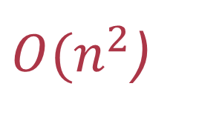
Recall last 6 weeks …
We have covered the studies of:
Algorithms.
Sorting algorithms
Bubble sorting & Cocktail-Shaker Sorting,
Selection Sorting & Insertion Sorting.
The Big-O Notation.
Data Structure & Abstract Data Type (ADT)
Singly Linked Lists
Doubly Linked Lists
Circular Linked Lists
${O(n}^{2}$)

Slide 4
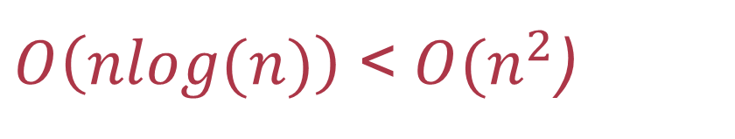
Next six weeks …
We will cover the studies of:
Data Structure & Abstract Data Type (ADT)
Stack – a container that implements the First In Last Out (FILO) rule.
Queue – a container that implements the First In First Out (FIFO) rule.
Tree – a ADT that reflects relationship of dependencies.
Algorithms.
Recursion with sorting algorithms
QuickSort.
MergeSort.
$O\left(nlog(n)\right)$< ${O(n}^{2}$)

Slide 5
Learning Outcomes
By the end of this session, you are expected to:
Understand what is stack and why should we use stack.
Be able to implement stack ADT in Java
Apply stack to solve some computational tasks.
Reverse a string.
Check balanced brackets.
Translate an integer string into an integer value.
Translate an integer value into an integer string.

Slide 6
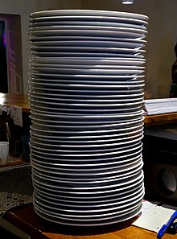
Stack
A stack is a logical concept that consists of a set of similar elements. The term is often used in programming and memory organization in computers.
Programming stacks are based on the principle of last in first out (LIFO), a commonly used type of data abstract that consists of two major operations, push and pop. The push operation adds an element to the bottom of stack while the pop operation removes an element from the top position.
Similar to a stack of plates, adding or removing is only possible at the top.

Slide 7
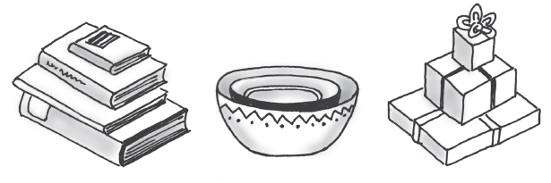
Stack in our daily life
Some familiar stacks
Add item on top of stack - push
Remove item that is topmost - pop

Slide 8

One more example
"A list of homogeneous elements in which the addition and deletion of elements occurs only at one end: called the Top of the stack".
Allows access to only the last element inserted
This mechanism is called
Last-In-First-Out (LIFO)
Stack of newspapers
top
bottom

Slide 9
Stack behaviour – “the in-tray”
LIFO (Last In First Out)
Push element on top
Pop element from the top
We will demonstrate working on pushing and popping the following items:
Orange
Apple
Banana
Stack
Banana
Operation:
Push
Operation:
Pop
Apple
Top
Orange

Slide 10
The key features
It is called as stack because it behaves like a real-world stack, piles of books, etc.
A Stack is a data structure that follows some order to insert and delete the elements, and that order can be LIFO or FILO.
It is an abstract data type (ADT) with a pre-defined capacity, which means that it can store the elements of a limited size.
You should NOT arbitrarily push infinite numbers of items to a stack!
This could eat out your memory and crash your system!
Your implementation MUST has a isFull() function to prevent stack overflow!

Slide 11
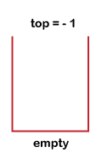
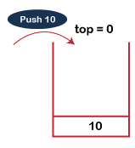
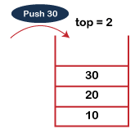
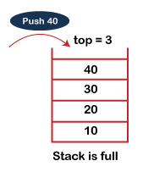
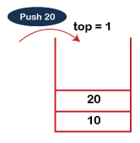
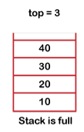
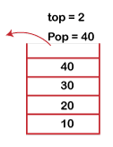
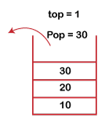
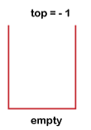
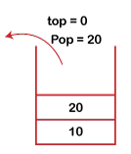
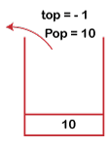
Implementation demo

Slide 12


Stack applications
Internet Web browsers store the addresses of recently visited sites on a stack. Each time a user visits a new site, that site’s address is “pushed” onto the stack of addresses. The browser then allows the user to “pop” back to previously visited sites using the “back” button.
Text editors usually provide an “undo” mechanism that cancels recent editing operations and reverts to former states of a document. This undo operation can be accomplished by keeping text changes in a stack.

Slide 13
Stack mandatory operations
Method | Description
push(x) | Adds a new element to the top of the stack. Prior to this operation, the stack must exist and must not be full (array implementation only).
pop() | Removes the top element of the stack. Prior to this operation, the stack must exist and must not be empty.
top() or peek() | Returns the top element of the stack. Prior to this operation, the stack must exist and must not be empty.
initialise() | create an empty stack
isFull()/isEmpty() | logical function returning whether the stack is full (only when implemented using arrays); logical function returning whether the stack is empty.
delete() | Destroy the full stack (Java garbage collector)

Slide 14
Stack optional operations
The following operations need also be defined.
count()/size(): It returns the total number of elements available in a stack.
change(): It changes the element at the given position.
display(): It prints all the elements available in the stack.

Slide 15
Stack implementations
The Stack ADT is either implemented with…
…an Array
A size limit needs to be specified to constrain the number of elements to a “maximum”.
or
…a Linked-List
No specific limit needs to be defined prior to run-time.
You need to prototype a scheme to check isFull()!
Both are concrete data-structures!

Slide 16
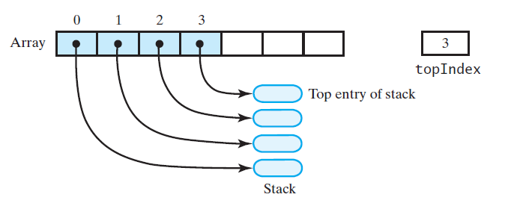
Array implementation
Need to declare an array Stack with a pre-fined size ahead of time (capacity).
Associated with each stack is topOfStack
for an empty stack, set topOfStack to -1
push(X)
Increment topOfStack by 1.
Set Stack[topOfStack] = X
pop()
Set return value to Stack[topOfStack]
Decrement topOfStack by 1
How to check isEmpty() and isFull()?
topOfStack = -1 => isEmpty()
topOfStack = size – 1 => isFull()

Slide 17
Stack exceptions
Exceptions are said to be "thrown" by an operation that cannot be executed.
In the Stack ADT, operations pop() and top() cannot be performed if the stack is empty. Attempting to do so throws an EmptyStackException, i.e., it results in an underflow error.
In Java, to raise an exception.
throw new Exception("Error messages");
try {
do_something();
} catch(Exception e) {
e.printStackTrace():
}
In our demos, stack is used to store strings. To simplify the demonstration, we will return a float value "-99999" to indicate the failure.

Slide 18
Stack implementation in an array
/**
* Constructor:Initialises a new instance of an array-based
* stack by filling it with the contents of an array
* @param arr the array of elements to add in the stack
* @param Stacksize the maximum size of the stack
*/
public WK07_ArrayStack(String [] arr, int stackSize) {
maxTop = stackSize - 1;
values = new String[stackSize];
int arraySize = arr.length;
int ceil = stackSize < arraySize ? stackSize : arraySize;
for(int i = 0; i < ceil; i++) {
values[i] = arr[i];
}
top = ceil - 1;
}
public class WK07_ArrayStack {
private int maxTop;
private int top;
private String [] values;
/**
* Initialises a new instance of an array-based stack.
*
* @param size the maximum size of the stack
*/
public WK07_ArrayStack(int size) {
maxTop = size - 1;
values = new String[size];
top = -1;
}
Initialise a stack!
Is stackSize < arraySize?
YES
NO
ceil = stackSize
ceil = arraySize

Slide 19
Stack implementation in an array (cont.)
/**
* Returns true if the stack is full, otherwise
* returns false.
*
* @return true if the stack is full, otherwise false
*/
public boolean isFull() {
return top == maxTop;
}
/**
* Returns true if the stack is empty, otherwise
* returns false.
*
* @return true if the stack is empty, otherwise false
*/
public boolean isEmpty() {
return top == -1;
}
public boolean push(String obj) {
if (isFull())
return false;
top ++;
values[top] = obj;
return true;
}
public String pop() {
if (isEmpty())
return "-99999";
String value = values[top];
values[top] = "";
top --;
return value;
}
If full, return false!
Otherwise, push the
object and return true
In the implementation, it prefer to use raising exception!
If empty, return -99999!
Otherwise, pop the
object and return it!

Slide 20
Stack implementation in an array (cont.)
Two more mandatory methods need to be implemented:
top() or peek(): similar to pop() but does not change top pointer and stack. It simply gets the object and return it if the stack is NOT empty!
delete(): simply delete all objects in the array and sets top to -1.
Optional methods (find your own ways to complete the work).
count()/size(): It returns the total number of elements available in a stack.
change(): It changes the element at the given position.
display(): It prints all the elements available in the stack.

Slide 21

Linked list implementation
Associated with each stack is topOfStack (a pointer to a ListNode)
The top of the stack remains at the front of the list, therefore pointed to by head! Values are added (pushed) at the front of the list.
For an empty stack, topOfStack points to null.
The stack grows downward, away from the head.
Methods needed from the SinglyLinkedList Class
push(x) void addFirst(x)
pop() int removeFirst()
top() getFirst()
Any things missing?
Do forget to define capacity!
Linked list allows infinite objects to be linked in your stack!
If no capacity is defined, you can screw up things by crashing computer system!
?
?
?

Slide 22


Stack applications
Print a string in a reverse pattern.
Check the braces {} and other operators are balanced.
Parsing the real integer value from an integer string.
Converting an integer value to an integer string.

